Slide 1
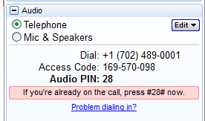
Welcome to the “Refreshing your probono.net Site’s Content and Design” webinar
If you joined the training via telephone, please select Telephone and enter your audio pin if you haven’t already.
If you joined with a microphone and headset or speakers (VoIP), please select Mic & Speakers.
We will start promptly at the hour.
Notes:
*

Slide 2
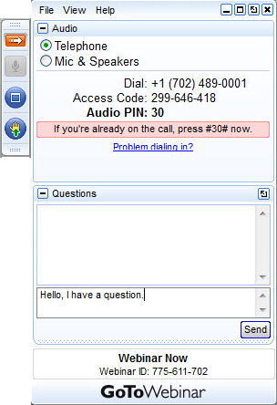
A few logistics before we start…
Maximize/minimize control panel with the orange arrow.
VOIP users select Mic & Speakers.
Telephone users select Telephone, and then enter the audio pin.
Ask a question or tell us something in the Questions box.
Notes:
Before we begin, I’d like to go over how the webinar tools work, particularly for those of you who are new to online trainings. We are using the GoToWebinar platform. As attendees, you have a control panel on the right hand side of your screen, like the one shown on the slide. You can minimize or maximize your control panel by clicking on the orange arrow at the top left of the panel. Most people’s control panel are set to minimize by default, and you will just see the small tool bar instead. Just click on the orange arrow to get your control panel back to size whenever you want it.
If you are joining us today by telephone you will need to enter your audio pin. If you are using VOIP, please make sure you have selected Mic & Speakers. You can switch between the two at any point if you want. You will lose audio briefly, but it shouldn’t take more than a minute to make the switch.
All callers have been automatically placed on mute, but we also encourage you to mute yourselves. We really want to hear your questions and feedback throughout the training. You can type a question at any time into the question log, and we’ll type the answer back to you – we may share any comments or questions in the comments box with all participants if appropriate. We will be pausing to answer questions at certain point during the training, during which you can use the “Raise hand” feature. By pressing this, we will unmute you to ask your question but please feel free to type into the questions box as your questions come up.
*

Slide 3

Today’s training is being recorded. Attendees will receive an email with a link to this information once it has been posted.
Notes:
I would like to note that this training is being recorded, so that we can make it available to you and your co-workers. You will receive an email once this material has been posted, with a link directing you to it. I welcome you to share the recording and other resources with your co-workers who might not have been able to attend today’s live training.
*

Slide 4
Refreshing your probono.net Site’s Content and Design
June 17, 2014
Notes:
*

Slide 5

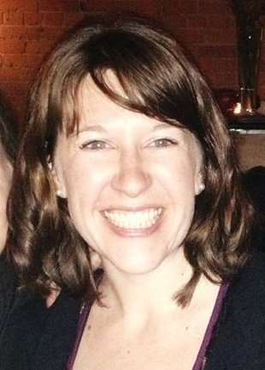
Presenters
Carol Austin
Charity Assist
Elizabeth Weaver
Montana Legal Services Association
Notes:
Carol Austin- Marketing and Communications Consultant who specializes in supporting nonprofit and charitable organizations. Carol has expertise in the legal sector having worked with a number of legal advocacy organizations in Canada, including work on two probono.net sites.
Elizabeth Weaver– AmeriCorps VISTA Pro Bono Enhancement Project Coordinator at Montana Legal Services Organization and worked on the refresh of Montanaprobono.net
*

Slide 6



Hosts
Adam Friedl
Pro Bono Net
Jake Hertz
Pro Bono Net
Jillian Theil
Pro Bono Net
Notes:
*

Slide 7
… a few key resources
2014 LawHelp.org and probono.net Training Series
http://www.probono.net/learningcenter/
probono.net HelpDesk
support@probono.net
Probono.net Admin Manual
http://www.probono.net/statewebsites/admin-manual/
Notes:
probono.net Coordinator call will be the first Tuesday in July (July 1st) at 10am PT.

Slide 8
Today we will cover …
Intro to Information Architecture
Useful site review tools on probono.net
The “How to” of reviewing/ updating your site
Examples from the community
Questions

Slide 9

What will you learn today?
Learn about the tools available on the probono.net platform for keeping content up to date
The “How to” of reviewing your site
How might you use information from today’s training to make improvements to your site?

Slide 10

A quick poll …
Tell us about your site review….

Slide 11
Information Architecture (IA)
“The art and science of organizing digital information … which means…consciously organizing the content and flow of a website”
Notes:
Source: http://www.theguardian.com/help/insideguardian/2010/feb/02/what-is-information-architecture

Slide 12
Why does this matter?
“Helps users understand where they are, what they’ve found, what’s around, and what to expect”
SIMPLE
CONCISE
CLEAR
DIRECTIVE
USEFUL
CONSISTENT
Notes:
Source: http://www.usability.gov/what-and-why/information-architecture.html
If you don’t invest resources in helping users get around your site – it will likely mean that users will have to invest more of their time on it trying to access what they need. If they can’t easily find it, they will probably be less likely to return to your site or use it as a resource.
Generally, words like SIMPLE, USEFUL, CONSISTENT, DIRECTIVE come to mind when thinking about the end goal.

Slide 13
What does it look like?
How users browse or move through information (navigation systems)
How you categorize and structure information (organizing schemes and structures)
How you represent information (labeling systems)
How users look for information (searching systems)
Notes:
Source: http://www.usability.gov/what-and-why/information-architecture.html
Examples (within the existing IA rules set by probono.net)
Navigation: projusticemn.org – tool bar, widgets on the side, center of their homepage, flexpages
Organizing schemes and structures - www.probono.net/statewebsites/library - – alphabetical, chronological, substantive area of law, by action item
Labeling systems:- Consistent, well thought-out, concise, useful labels are important. May be helpful to be directive.
Search – search functionality on probono.net (but think of how getting these other systems in place will enhance the experience of using the probono.net search!)

Slide 14
What are some useful probono.net tools for a review?
Navigation:
  Custom Resource Pages
  Flex Pages
Content Tools:
  Content Syndication Widgets
  RSS Feed Importer Tool
  Shared Content Tool
Design Options – custom or using existing probono.net features
Notes:
Example: http://www.probono.net/statewebsites (for flex page, widget, shared content)
Design options: http://www.projusticemn.org/
Also, see the admin manual or http://www.probono.net/statewebsites/trainingseries2014/516121.2014_LawHelp_and_probononet_Training_Series_Nuts_and_Bolts_of_your_probono for more details about how to use these tools.

Slide 15

Now… let’s look at IA put into practice!

Slide 16

Website Content Management
spring cleaning For your website

Slide 17
How much cleaning should I do?
Critical Maintenance
Full Site Audit
Redesign

Slide 18
Critical Maintenance
Find & fix broken links
  Use a link checker
    http://lawhelp.wordpress.com/2014/04/17/brokenlinkchecker/#more-936
  Set external links to open in a new page
  Prioritize to review links on a regular schedule
Delete or archive old items
  Consider using a blog for time-limited items
  Integrate RSS feed in a widget
Notes:
*Link checkers will only work on pages in front of a password
* Note that if you set a resource’s status to “Deleted” on the probono.net platform, you can still access that resource in the admin inbox indefinitely.

Slide 19
Critical Maintenance
Home Page Cleanup
  Is the information accurate?
  Is there outdated content?
  Is it clear what the site is about?
  What is the message to your audience? What do you want a user to do?
  Are you using hyperlinks to direct a user where you want them to go?
  Have you integrated social media tools/icons?

Slide 20
Critical Maintenance
Other Important Pages:
  Contact Pages
    Is information current? (staff changes)
  Support Pages
    Are hyperlinks working properly?
    Is there a call-to-action?
  Most Trafficked Pages
    Check hyperlinks
    Refresh content, clean-up fonts, errors, etc.
  Privacy Policy / Legal
    Ensure still accurate

Slide 21
Full Site Audit
Review online goals
  Are you meeting those goals now?
Review site navigation
  Is navigation intuitive?
  Can pages be combined/consolidated?
  Are new pages needed?
  Are new tools needed?
  Can you integrate social media tools?
  Can you set up a blog for time-limited content?
  Can you use other widgets with RSS feeds?
Review visual / graphical elements
  Discuss options with Pro Bono Net

Slide 22
Content Management Best Practices
Ensure consistent branding and program messaging
Ensure consistent tone and voice
No typos or grammatical errors
Ensure logos are used correctly

Slide 23
Content Management Best Practices (cont.)
Ensure consistent fonts used throughout
Repair broken links
Set external links to open in a new page
Reduce cluttered pages
Eliminate/archive out-dated information

Slide 24
Accessibility Best Practices
Check that all images and logos have descriptive “alt text” entered
Use heading tags on headings for people using screen readers
Avoid hyperlinks on non-descriptive text:
  WRONG: “Click here for the year end report.”
  RIGHT: “Click here for the year end report.”

Slide 25

Questions
Carol Austin
Marketing & Communications Consultant
www.charityassist.net
carol@charityassist.net
416-546-5252

Slide 26
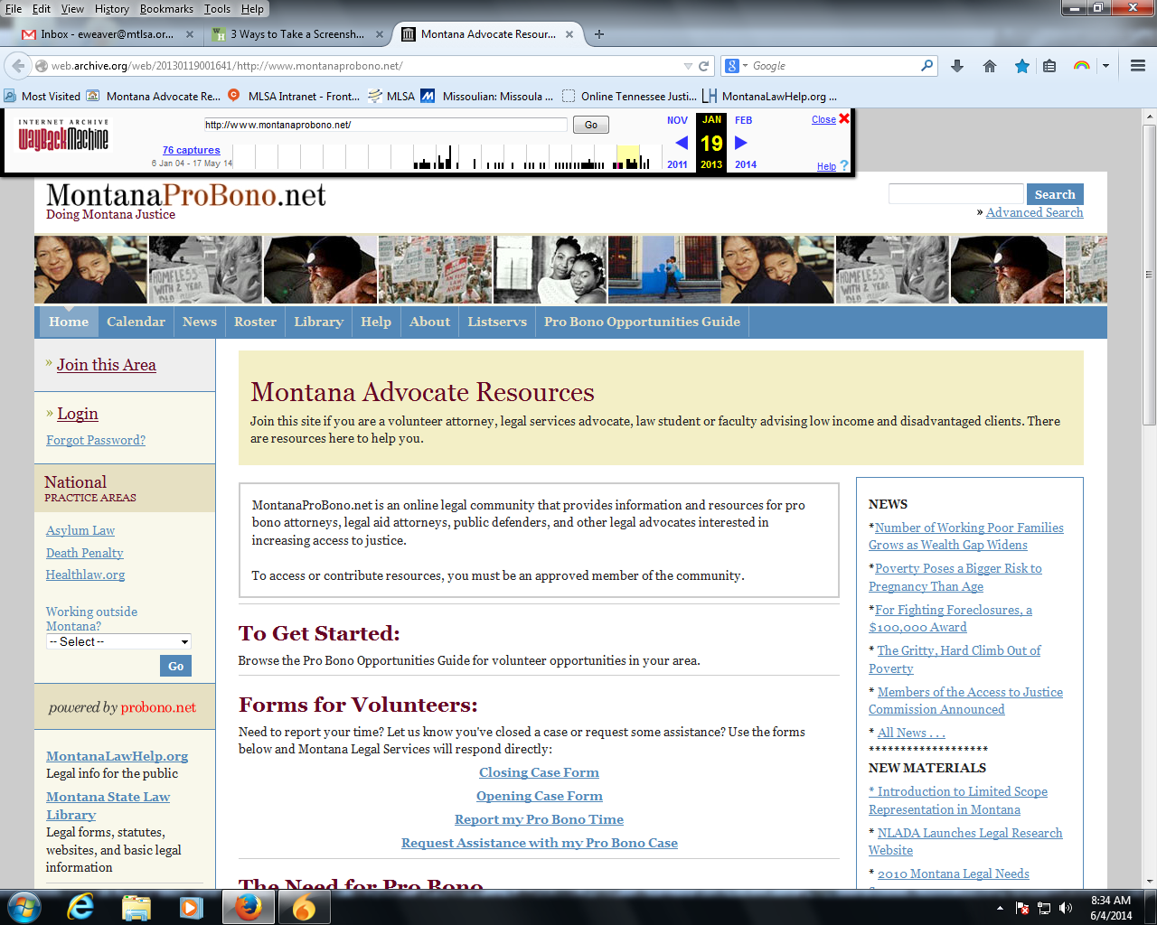
Notes:
Before the refresh

Slide 27
Reasons for Refresh
Out of date information
Site was not regularly maintained
Low traffic
No “perks” for users

Slide 28
Features Added & Tools Used
Resource Widget
RSS feed option
Find a Case
Custom Resource Pages & Flex Content Page
Law Student Page
Volunteer Opportunities vs. Pro Bono Opportunities

Slide 29
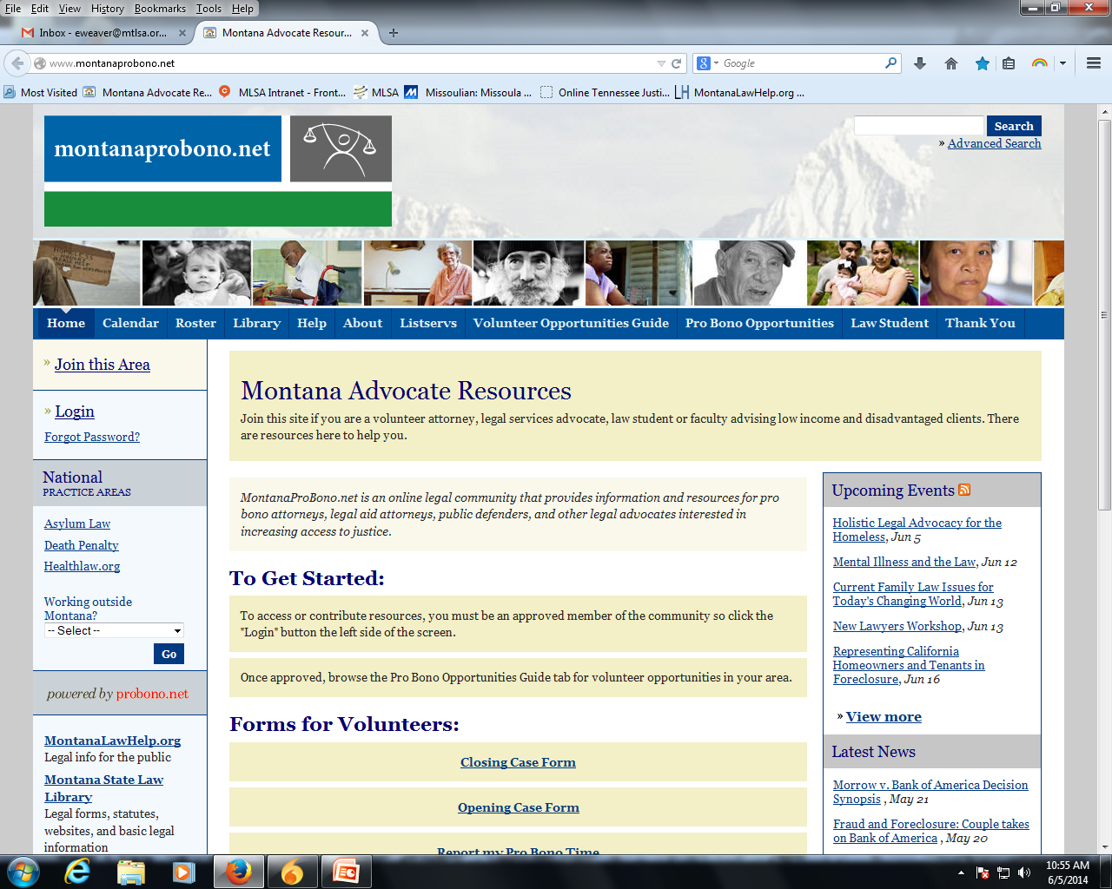
Notes:
After the refresh

Slide 30
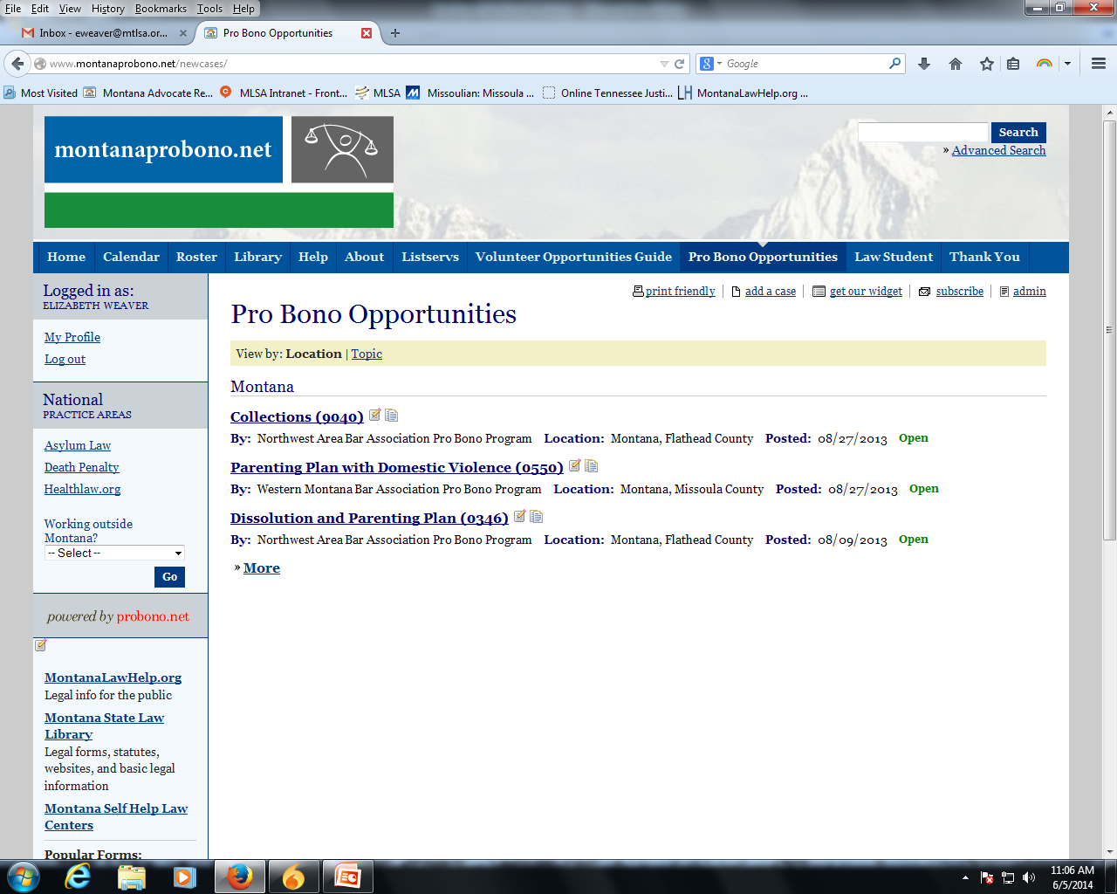

Slide 31
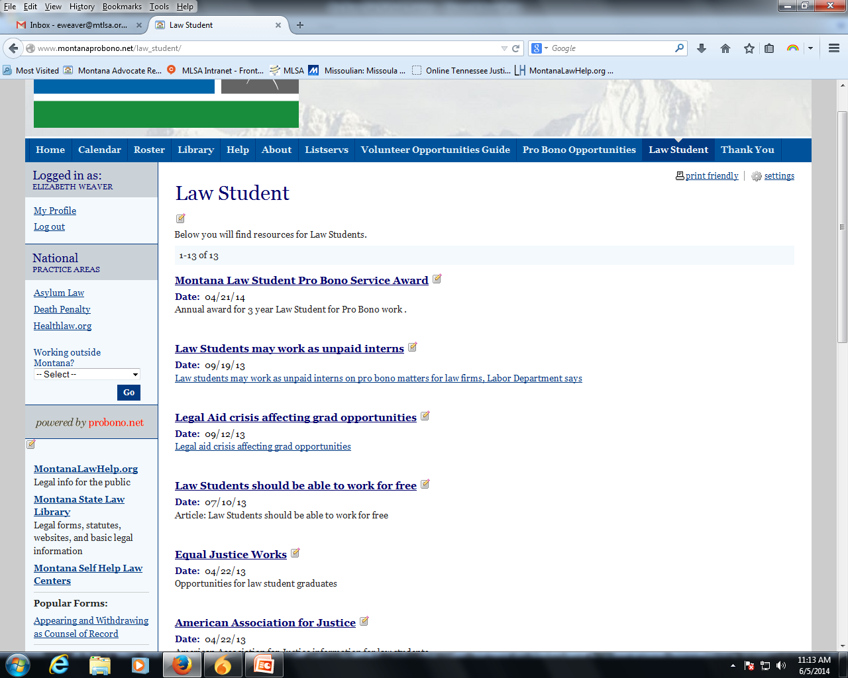

Slide 32

Questions?
Don’t forget to take our feedback survey!
Notes:
Survey link: https://www.surveymonkey.com/s/JZHTXVP
If we don’t get to your question,
please feel free to contact us at support@probono.net.
What stakeholders did you need to take into consideration and how did you navigate that?
How do/did you determine that a review/revamp is/was successful?
Any input about spreading the word about a revamped site to relevant stakeholders?
In terms of a maintenance plan going forth, do you have any recommendations?
*

Slide 33
Thank you for attending today!
Next up:
Mobile Delivery Strategies Using LawHelp
July 10, 2014
More information at
http://www.probono.net/learningcenter/
Notes:
Next probono.net training will be Creating and Presenting Training and Essential Resources on your probono.net Site on Tuesday, August 12.
*

