Slide 1
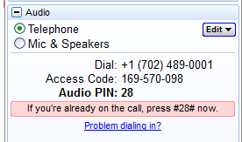
Welcome!
If you joined the training via telephone, please select Telephone and enter your audio pin if you haven’t already.
If you joined with a microphone and headset or speakers (VoIP), please select Mic & Speakers.
We will start promptly at the hour.
Thank you for joining us!
Notes:
*

Slide 2
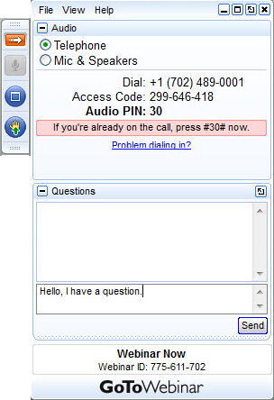
A few logistics before we start…
Maximize/minimize control panel with the orange arrow.
VOIP users select Mic & Speakers.
Telephone users select Telephone, and then enter the audio pin.
Ask a question or tell us something in the Questions box.
Notes:
Before we begin, I’d like to go over how the webinar tools work, particularly for those of you who are new to online trainings. We are using the GoToWebinar platform. As attendees, you have a control panel on the right hand side of your screen, like the one shown on the slide. You can minimize or maximize your control panel by clicking on the orange arrow at the top left of the panel. Most people’s control panel are set to minimize by default, and you will just see the small tool bar instead. Just click on the orange arrow to get your control panel back to size whenever you want it.
If you are joining us today by telephone you will need to enter your audio pin. If you are using VOIP, please make sure you have selected Mic & Speakers. You can switch between the two at any point if you want. You will lose audio briefly, but it shouldn’t take more than a minute to make the switch.
All callers have been automatically placed on mute, but we also encourage you to mute yourselves. We really want to hear your questions and feedback throughout the training. You can type a question at any time into the question log, and we’ll type the answer back to you – we may share any comments or questions in the comments box with all participants if appropriate. We will be answering questions at the end of the training, but please feel free to type into the questions box as your questions come up.
*

Slide 3

Today’s training is being recorded. Attendees will receive an
email with a link to this information once it has been posted.
Notes:
I would like to note that this training is being recorded, so that we can make it available to you and your co-workers. You will receive an email once this material has been posted, with a link directing you to it. I welcome you to share the recording and other resources with your co-workers who might not have been able to attend today’s live training.
*

Slide 4
Creating and Organizing Content for your LawHelp.org Client Community
May 28, 2014
Featuring:
Danielle Rebar, Northwest Justice Project
Mary Rea, Legal Services State Support
Notes:
*

Slide 5
Agenda
Introduction to Information Architecture
Creating accessible resources
Creating accessible organizations
News and Updates
Questions

Slide 6
… a few key resources
SWEB Library:
  Manage Your Site
    Admin Help
    Develop Content>Create/Select/Find/Manage Content
  Evaluate Your Site
LH3 Support Portal Quick Start Guides
Creating Content Trainings
  April 2014 Coordinator Call (IAN Resources)
  UPCOMING: Consumer Finance Protection Buero’s Mary Griffin will talk about client-facing resources available on their site.
Notes:
probono.net Coordinator call will be the first Tuesday in May (May 6th) at 10am PT.

Slide 7

What will you learn today?
Information architecture concepts
Using these concepts on your site
Models to create and maintain
content that are current and
user/administrator friendly
How might you use information from today’s training to make improvements to your site?
Notes:
Today’s goal: Present variety of tools that are available on the probono.net platform for volunteer attorney engagement and to learn how members of our community are using these tools within their larger outreach and recruitment strategy. I also want to challenge you today to ask yourself: how might you use information from today’s training to make improvements to your site?

Slide 8
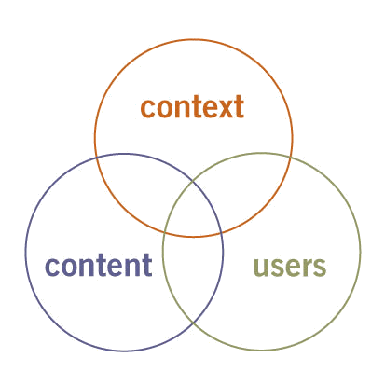

What is Information Architecture?

Slide 9
New ways to think about your IA
Many front doors to your site
  Experience mapping can help focus you on the needs of your users, and on their navigation pathways

Slide 10
LawHelp.org Site Structure
Topic
Subtopic
Channel
Category
Tags
Content!

Slide 11
Labels
Simple 1-2 word descriptive labels
Categorize based on
  Type/format of content
  Legal sub-specaility
  Population
  If you want to categorize based on two of these- use channels and tags
Best practice: Consistent across your site

Slide 12
Navigation
Simple
Instructive content
Linking inter-related content
On point navigation assistance

Slide 13
Search
Content Titles
  Short concise
  Easy to understand
  Descriptive
Scanable descriptions

Slide 14
Test!!!
Who should I use?
  Advocates
  Users
  Stakeholders
What should I test?
  Label changes
  Navigation flow changes
  Navigation assistance
  Anything and everything
How should I test?
  A/B testing with an online form in a waiting room
  Survey sent out to advocates
  Using online user testing services
  Where are there captive audiences? How can you get information from them?

Slide 15
Good Content Drives Great Sites-
Start with content

Slide 16

Danielle Rebar, Web Site/Publications Manager,
WashingtonLawHelp.org Northwest Justice Project
Legal Education Resources
Making your LH3 Content Accurate, Friendly and Accessible

Slide 17
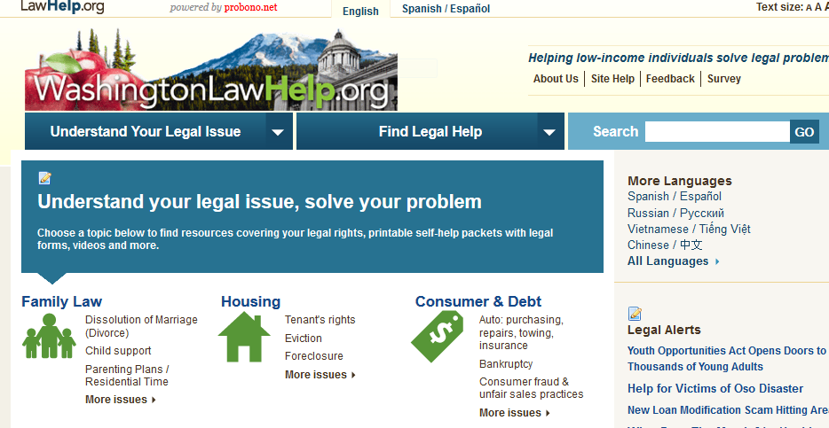
WashingtonLawHelp.org
Team: Legal Content Editor and Website Manager
350 pieces of original content
600+ links to external content
Notes:
Legal Content Editor: Originally had an “adopt a publication” policy where advocates were required to volunteer to update one or more pieces of content. Didn’t work out well. Push to create a “Legal Content Editor” position prevailed.

Slide 18

What should we link to?
  By request from staff AND
  priority subject matter OR
  reaches priority audience OR
  after legal development (new legislation, change in legislation, court decision, new regulations, change in regulations, etc.) AND
  after we’ve established that this is the simplest, best resource on this subject
Notes:
At this point, most of the new links we’re adding are suggested by staff or come to our attention via listservs, etc.

Slide 19
Maintaining external content
Fix broken links: download Link Checker: http://wummel.github.io/linkchecker/
Annual review of external content
Notes:
Everyone gets annoyed when they get a page not found error. Here are some ways to help keep your links up to date. Warning: linkchecker will run for hours before completing the report. Xander has a detailed review of this on the blog.
Publications editor periodically reviews external content to make sure still relevant

Slide 20
When do we create new content?
  By request OR
  upon review of existing resources OR
  in response to new legal development AND
  when it is a priority matter OR reaching priority audience OR consistent with Strategic Plan

Slide 21
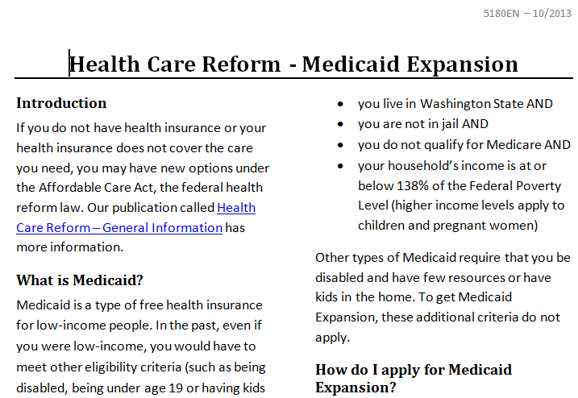
How do we make resources readable?
Readability
  Use of Plain Language guidelines
  HTML - Q & A format with questions listed above content with jump links to answers
  Pdfs are formatted in 2 column format with lots of white space and short, bulleted paragraphs

Slide 22
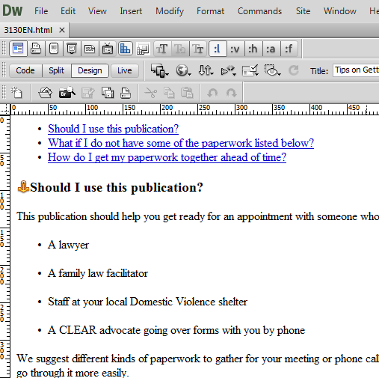
How do we make our resources accessible?
  Offer resources in both html and pdf
  Follow html accessibility guidelines
  Use Dreamweaver to easily create html versions of your resources
  Make sure pdfs created with tags
Notes:
You can copy and paste in text from Word to Dreamweaver to easily create html versions.

Slide 23
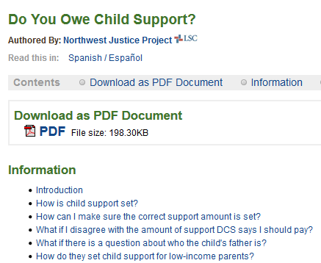
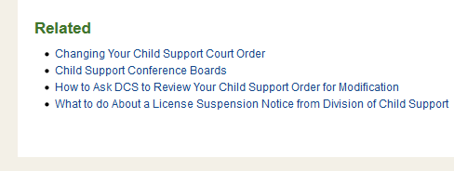
Resource page set-up
Example Resource Page
Consistently order resource modules:
  Pdf attachment
  Html
  Related Resources
Notes:
We went through every resource and established 3-4 related resources for each one. This allows the user to move forward and read more on a particular topic without having to use the back button or start over looking for another resource.

Slide 24
Contact:
Danielle Rebar
Web Site/Publications Manager,
Northwest Justice Project
DanielleR@NWJustice.org

Slide 25

Organization Profiles
Connecting LawHelp Users with Programs and Agencies
Mary Rea, Communications Coordinator, Legal Services State Support

Slide 26

Find Legal Help (14) (Channel)
(Categories)
Legal Aid Offices (5)
Court Self-Help Centers / Law Libraries (3)
Legal Clinics (3)
Mediation and Dispute Resolution (1)
Private Attorneys (2)

Slide 27
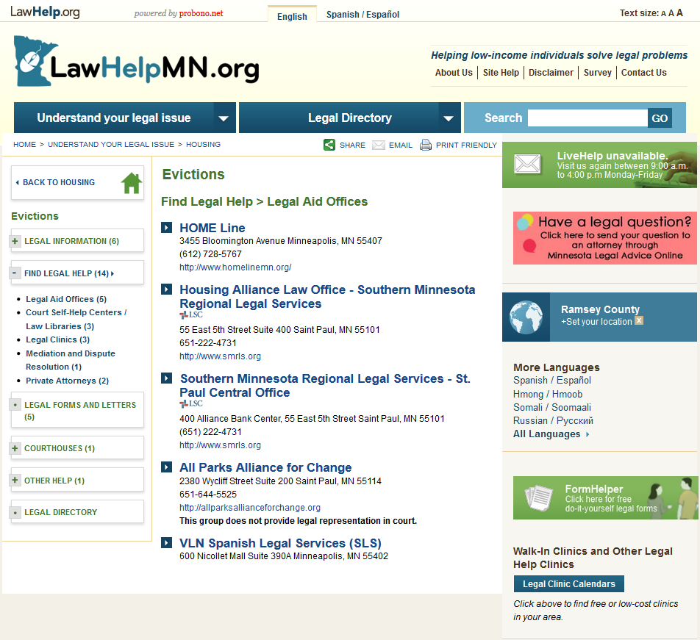

Slide 28
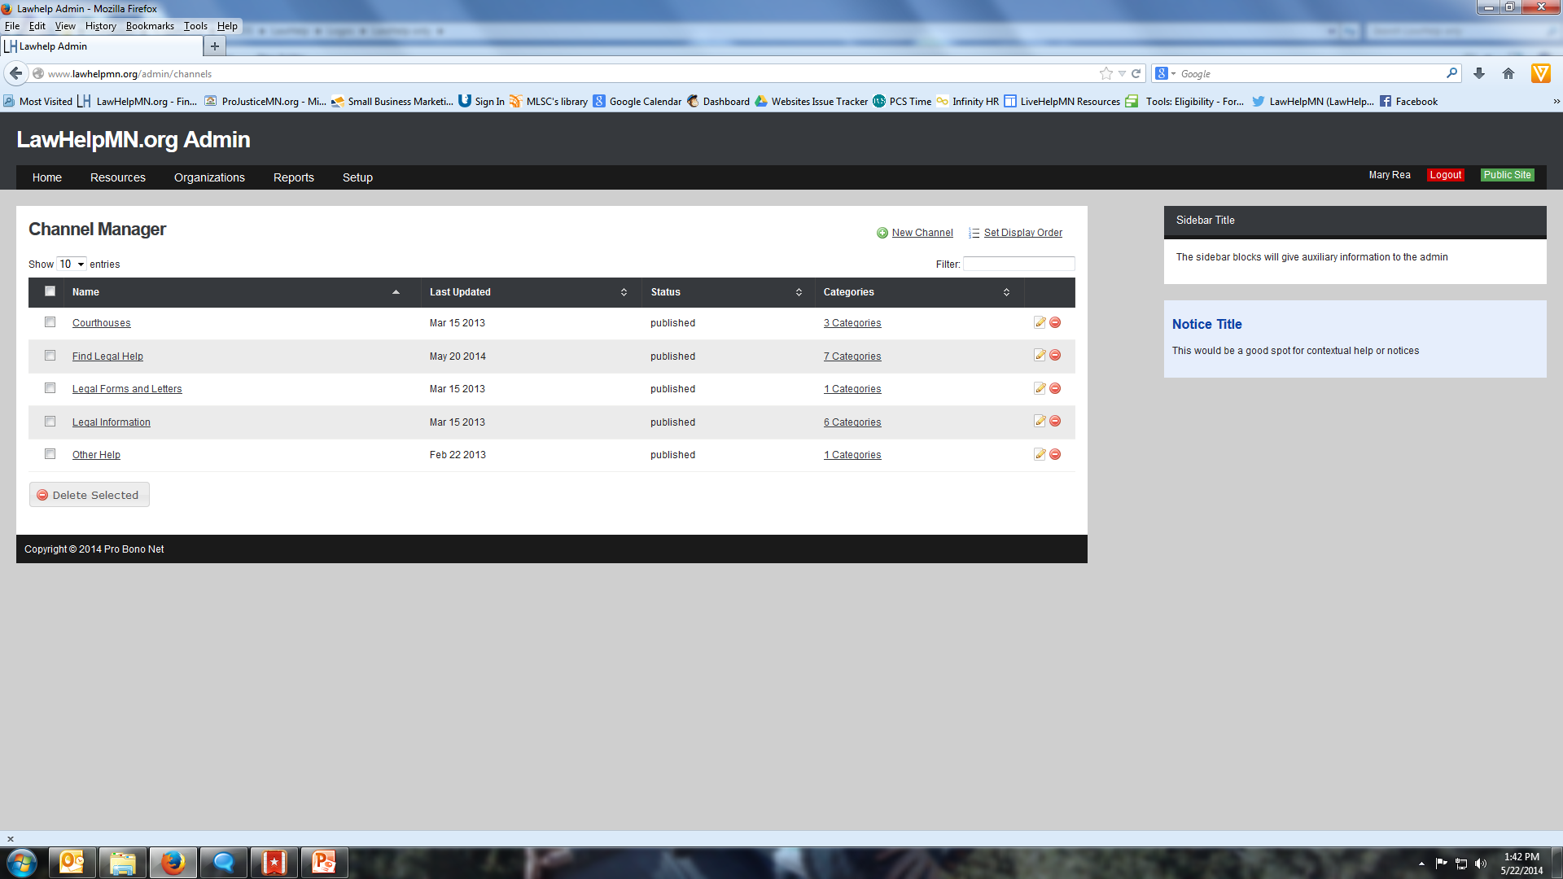

Slide 29
Collaborations
Who should be on LawHelpMN.org?
Find Legal Help (14) (Channel)
(Categories)
Legal Aid Offices (5)
Court Self-Help Centers / Law Libraries (3)
Legal Clinics (3)
Mediation and Dispute Resolution (1)
Private Attorneys (2)
Any private firm offering reduced fee or sliding scale civil legal services
Any social service agency offering free legal advice clinic or services as one of its programs
Law Libraries

Slide 30
United Way 2-1-1 and C4J
Leveraging Partner Knowledge and Resources
  United Way 2-1-1 provides free and confidential information and referral for help with food, housing, employment, health care, counseling, etc.
  United Way partnership with Call for Justice (an access to justice non-profit that connects low-income people to existing legal resources) led to our effort to expand organizations included on the Find Legal Help channel.
  State Support researched and filtered a comprehensive spreadsheet of area agencies and programs provided by United Way, and candidate organizations were identified.
  Law student volunteers were engaged to reach out to targeted organizations about LawHelpMN, and our desire to include them on the Find Legal Help channel.
  Profiles were created for organizations that provided additional information.

Slide 31
State and County Law Libraries
Leveraging Partner Knowledge and Resources
  A law school “county resource flyer” student project led to the idea of creating county law library profiles on LawHelpMN
  Each county has a law library – some are staffed minimally, and most have a phone number to call. Some have websites.
  All topics and subtopics are selected for each county profile, which is then filtered for the specific county.
  The Minnesota State Law Library’s profile appears with each county’s profile in search results based on location, and within every topic/subtopic.

Slide 32

Contact:
Mary Rea
Communications Coordinator
Legal Services State Support
651-842-6906
mrea@mnlegalservices.org

Slide 33

News from PALawHelp.org
Information from Hank Leone- Training and Information Facilitator,
Pennsylvania Legal Aid Network

Slide 34
Why?
Keeps your client base up to date
Makes your site more dynamic
  Increases your SEO ranking
  Your site appears in alerts etc
  Increased visibility
Can also work with site or agency blogs (by simply reposting the blog text as a resource to your site).

Slide 35
Where the content comes from
RSS feeds/newsletters from state and Federal agencies
Google alerts set up for legal aid programs
Twitter and Facebook for government and social service agencies.
Direct outreach (from other agencies)

Slide 36
Sources of News
Consistent content can be found at:
  PA Attorney General
  Consumer Protection Bureau
  FTC
Other good sources are the
  Social Security Administration,
  PA Governor’s Office,
  Internal Revenue Service

Slide 37

Creating the content
Find or create news article/press release
Create a new resource
Tag the resource as News

Slide 38
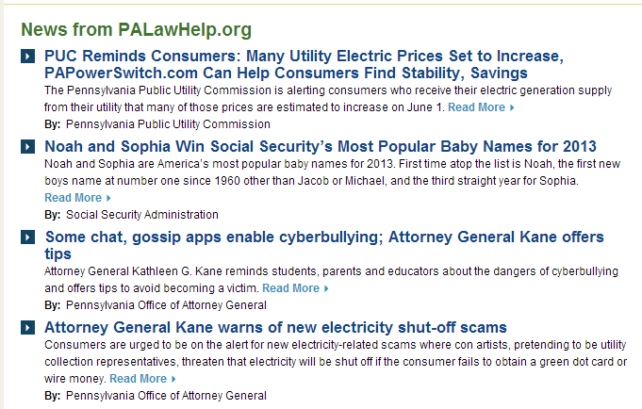
News from PALawHelp.org
Content Page pulls in all resources tagged with “News”

Slide 39

Key questions
Is your site/content/web presence…
Easy to find?
Easy to read?
Easy to use?
Current?
Simple?
Concise?

Slide 40
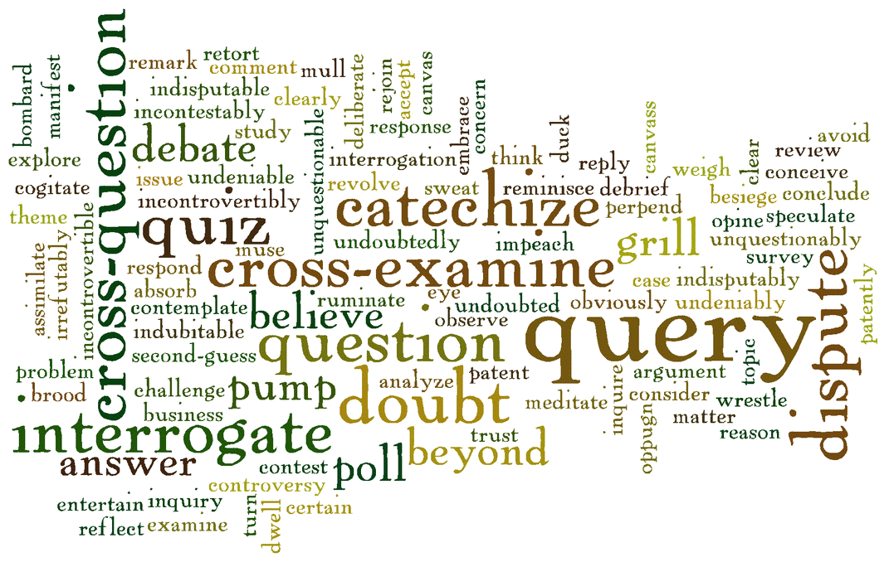
Questions?
Don’t forget to take our feedback survey!
Notes:
Survey link: https://www.surveymonkey.com/s/JZHTXVP
If we don’t get to your question, please feel free to contact us at support@probono.net.
*

Slide 41
Thank you for attending today!
Of Interest:
Mary Griffin of the CFPB.gov
June 2, 1 pm ET/ 12 CT/ 11am MT/ 10 am PT
Next up:
probono.net: Refreshing your Site's Content & Design
June 17 2014
LawHelp: Mobile Delivery Strategies Using LawHelp
July 10th 2014
More information at: probono.net/learningcenter/
Notes:
Next probono.net training will be Refreshing your probono.net Site’s Content and Design on Tuesday, June 17 at 11am.
*

